Slide 1

Reaction time
Research – Daonhan Tran
Advisor – Vins Sutlive

Slide 2
Introduction
Reaction time is the duration between the sensory stimulus's appearance and the consequent behavioral response
Reaction time involves the central and peripheral components of the human body and is used as a tool to reflect human cognitive and motor functions
Reaction times is a response we use in our everyday life
Several factors affect the human body's reaction times

Slide 3
Backgrounds
There are two main components of a reaction times test: auditory and visual reaction times
A research study conducted by Thompson showed that humans have a faster reaction time when it comes to audio stimuli compared to visual stimuli
(Kemp, et al., 1973) shows that auditory stimuli take only 8-10 millisecond to reach the brain, while on the other hand, a visual stimulus can take up to 20-40 millisecond
A 2010 study by Shelton show that auditory reaction time is faster than visual by 47 milliseconds
A 2015 study done by Jain et al., 2015 compare visual and auditory reaction times. It result show that the auditory stimulus was significantly less as compared to the visual stimulus.

Slide 4
Hypothesis
The purpose of this study is to find out whether reaction time is faster for auditory or visual stimuli and how distraction can be responsible for delaying reaction time
Our hypothesis for this study is that audio stimuli reaction time will be faster than visual stimuli.
With the addition of the distraction variable, we predict that the reaction time will go up but we still expected for the audio stimuli reaction time to be faster than the visual stimuli.

Slide 5
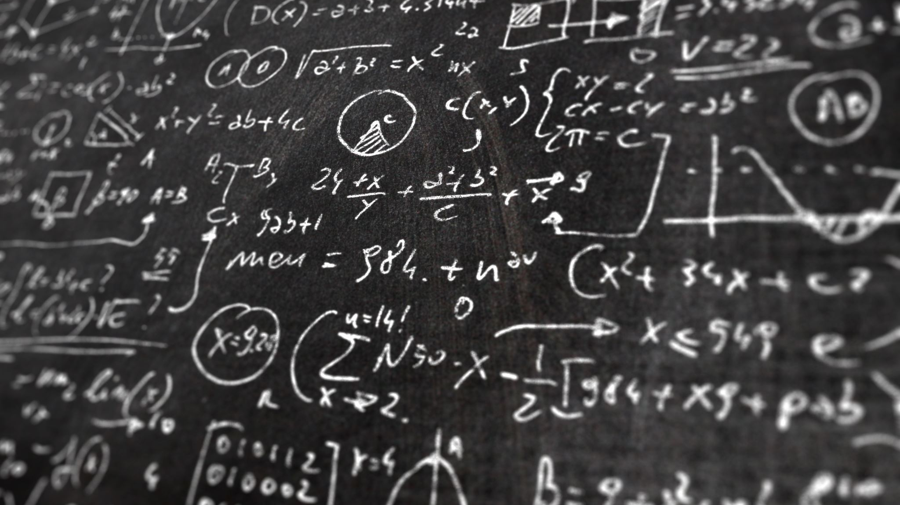
Methods
50 volunteer subjects
Two program use for the experiment
There are 5 groups with 10 people in each groups
Each groups have different task from each other

Slide 6
 | VRT | ART | VRT-D | ART-D
Means (ms) | 293.7 | 243 | 412.1 | 324.6
Standard deviations | 39.96123 | 29.96665 | 76.28084 | 48.14838

Slide 8
 | VRT | ART | VRT-D | ART-D
Means (ms) | 268.4 | 225.4 | 355.5 | 317.9
Standard deviations | 21.05327 | 34.70504 | 63.57712 | 66.59197

Slide 10

Discussion
This study aims to determine whether reaction time is faster for auditory or visual stimuli and how distraction can be responsible for delayed reaction time.
The mean for the audio reaction time is 243 milliseconds compared to the mean for the visual reaction time of 293.7 milliseconds.
Our results also show similar results to the studies done by Shelton & Kumar
With the addition of the distraction variable, the reaction times for both audio and visual stimuli increased
The mean for the audio reaction time with distraction is 324.6 milliseconds, and the mean for the visual reaction time with distraction is 412.1 milliseconds

Slide 11
Application
55 mph = 25 m/s
Take 3 seconds to stop once brake is applied (RT + Braketime)
Travel distance = 75m
Distraction adds .50sec
Travel distance = 87.5m

Slide 12
Future study
Future research should continue to examine the differences in reaction time, dependent on the difference in distraction variables.

Slide 13
References
Balakrishnan G, Uppinakudru G, Girwar Singh G, Bangera S, Dutt Raghavendra A, Thangavel D. A comparative study on visual choice reaction times for different colors in females. Neurol Res Int. 2014;2014:301473. doi: 10.1155/2014/301473. Epub 2014 Dec 16. PMID: 25580294; PMCID: PMC4280496.
Ashnagar Z, Shadmehr A, Jalaei S. The effects of acute bout of cycling on auditory & visual reaction times. J Bodyw Mov Ther. 2015 Apr;19(2):268-72. doi: 10.1016/j.jbmt.2014.05.003. Epub 2014 May 15. PMID: 25892382.
Thompson PD, Colebatch JG, Brown P, Rothwell JC, Day BL, Obeso JA, Marsden CD. Voluntary stimulus-sensitive jerks and jumps mimicking myoclonus or pathological startle syndromes. Mov Disord. 1992;7(3):257-62. doi: 10.1002/mds.870070312. PMID: 1620144.
Kemp, B. J. (1973). Reaction time of young and elderly subjects in relation to perceptual deprivation and signal-on versus signal-off conditions. Developmental Psychology, 8(2), 268–272. https://doi.org/10.1037/h0034147
Der G, Deary IJ. Age and sex differences in reaction time in adulthood: results from the United Kingdom Health and Lifestyle Survey. Psychol Aging. 2006 Mar;21(1):62-73. doi: 10.1037/0882-7974.21.1.62. Erratum in: Psychol Aging. 2009 Mar;24(1):229. PMID: 16594792.
Jain A, Bansal R, Kumar A, Singh KD. A comparative study of visual and auditory reaction times on the basis of gender and physical activity levels of medical first year students. Int J Appl Basic Med Res. 2015 May-Aug;5(2):124-7. doi: 10.4103/2229-516X.157168. PMID: 26097821; PMCID: PMC4456887.
J. Shelton and G. Kumar, "Comparison between Auditory and Visual Simple Reaction Times," Neuroscience and Medicine, Vol. 1 No. 1, 2010, pp. 30-32. doi: 10.4236/nm.2010.11004.
Yager, C. E. (2013). Driver Safety Impacts of Voice-to-Text Mobile Applications. Proceedings of the Human Factors and Ergonomics Society Annual Meeting, 57(1), 1869–1873. https://doi.org/10.1177/1541931213571417

Slide 14
The end
Questions

